Slide 1
DATABASE SYSTEM DEVELOPMENT LIFECYCLE Session 9
Course : ISYS6280 – Database Systems (GAT)
Year : 2015

Slide 2
LEARNING OUTCOME
LO 1 : LO 1: Describe database systems, terminology, environment, and new concept of database

Slide 3
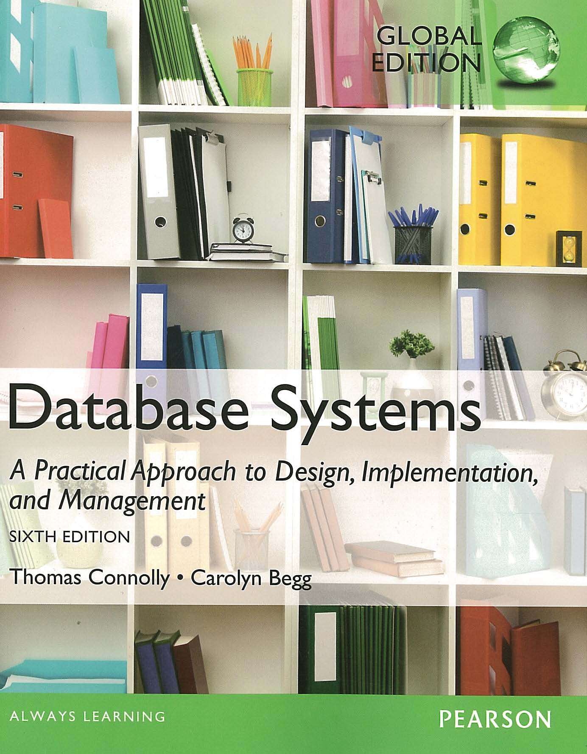
ACKNOWLEDGEMENT
These slides have been adapted from Thomas Connolly and Carolyn Begg. 2015. Database Systems: A Practical Approach To Design, Implementation, and Management. Pearson Education. USA. ISBN:978-1-292-06118-4

Slide 4
CHAPTER 10 DATABASE SYSTEM DEVELOPMENT LIFECYCLE

Slide 5
LEARNING OBJECTIVES
Main components of an information system.
Main stages of database system development lifecycle.
Main phases of database design: conceptual, logical, and physical design.
The types of criteria used to evaluate a DBMS
How to evaluate and select a DBMS
The Benefits of Computer-Aided Software Engineering (CASE) tools.

Slide 6
Database System Development Lifecycle
Database is fundamental component of IS, and its development/usage should be viewed from perspective of the wider requirements of the organization.
The Database System Development Lifecycle is inherently associated with the lifecycle of the information system
It is important to recognize that the stages of the database system development lifecycle are not strictly sequential but involve some amount of repetition of previous stage through feedback loops.

Slide 7
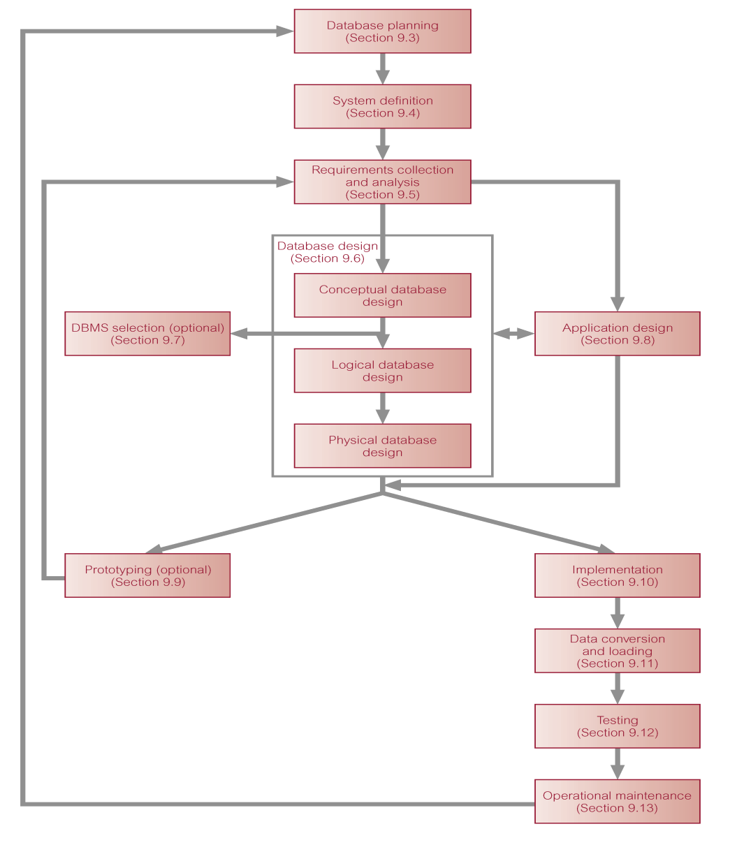
Database System Development Lifecycle
Page 348, Connolly Database Systems

Slide 8
1. Database Planning
In this step we define mission statement for database system which is objectives for our database applications
Once mission statement is defined, mission objectives are defined.
Each objective should identify a particular task that the database must support.

Slide 9

1. Database Planning
Database planning should also include development of standards that govern:
how data will be collected,
how the format should be specified,
what necessary documentation will be needed,
how design and implementation should proceed.
2020projectmanagement.com

Slide 10
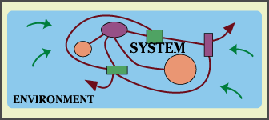
2. System Definition
Describes scope and boundaries of database system and the major user views.
User view defines what is required of a database system from perspective of:
a particular job role (such as Manager or Supervisor) or
enterprise application area (such as marketing, personnel, or stock control).
www.ticopa.com

Slide 11
2. System Definition
Database application may have one or more user views.
Identifying user views helps ensure that no major users of the database are forgotten when developing requirements for new system.
User views also help in development of complex database system allowing requirements to be broken down into manageable pieces.

Slide 12
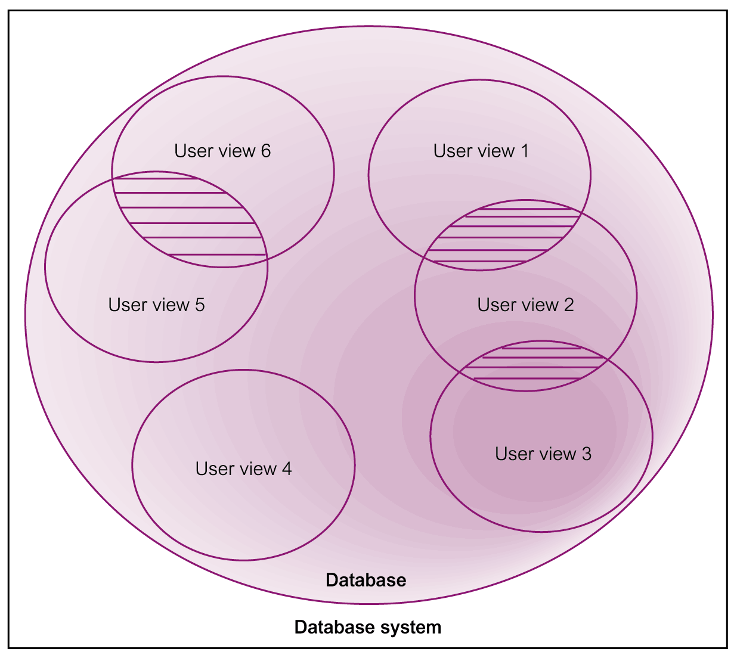
Representation of a Database System with Multiple User Views

Slide 13
3. Requirements Collection and Analysis
Process of collecting and analyzing information about the part of organization to be supported by the database system, and using this information to identify users’ requirements of new system.
Information is gathered for each major user view including:
a description of data used or generated;
details of how data is to be used/generated;
any additional requirements for new database system.

Slide 14
3. Requirements Collection and Analysis
Information is analyzed to identify requirements to be included in new database system. Described in the requirements specification.
Another important activity is deciding how to manage the requirements for a database system with multiple user views.
Three main approaches:
centralized approach;
view integration approach;
combination of both approaches.

Slide 15
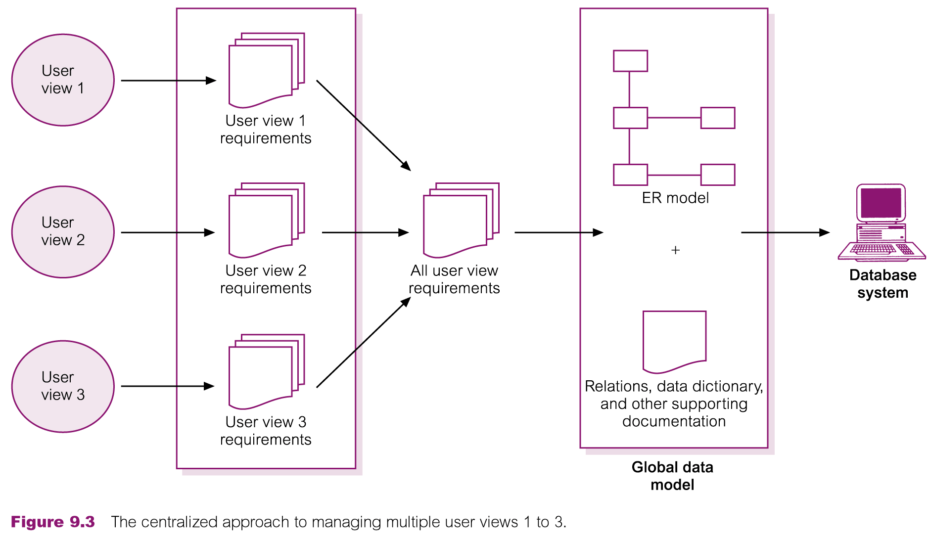
Centralized Approach to Managing Multiple User

Slide 16
View Integration Approach
Data model representing single user view (or a subset of all user views) is called a local data model.
Each model includes diagrams and documentation describing requirements for one or more but not all user views of database.
Local data models are then merged at a later stage during database design to produce a global data model, which represents all user views for the database.

Slide 17
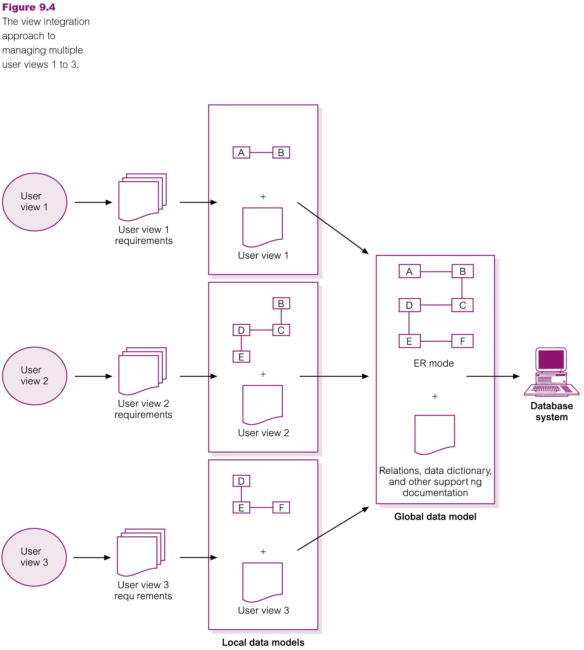
View Integration Approach to Managing Multiple User View

Slide 18
4. Database Design
Process of creating a design for a database that will support the enterprise’s mission statement and mission objectives for the required database system.
Main approaches include:
Top-down
Bottom-up
Inside-out
Mixed : uses both bottom-up and top-down

Slide 19

4. Database Design
Building data model requires answering questions about entities, relationships, and attributes.
A data model ensures we understand:
- each user’s perspective of the data;
- nature of the data itself, independent of its physical representations;
- use of data across user views.
www.compbuilding.com

Slide 20
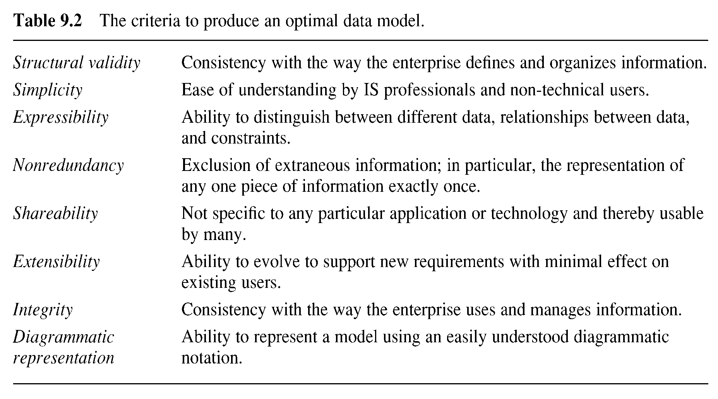
Criteria to Produce an Optimal Data Model

Slide 21
Three phases of database design
Conceptual database design
Logical database design
Physical database design.

Slide 22
4.1 Conceptual Database Design
Process of constructing a model of the data used in an enterprise, independent of all physical considerations.
Data model is built using the information in users’ requirements specification.
Conceptual data model is source of information for logical design phase.

Slide 23
4.2 Logical Database Design
Process of constructing a model of the data used in an enterprise based on a specific data model (e.g. relational), but independent of a particular DBMS and other physical considerations.
Conceptual data model is refined and mapped on to a logical data model.

Slide 24
4.3 Physical Database Design
Process of producing a description of the database implementation on secondary storage.
Describes base relations, file organizations, and indexes used to achieve efficient access to data. Also describes any associated integrity constraints and security measures.
Tailored to a specific DBMS system.

Slide 25
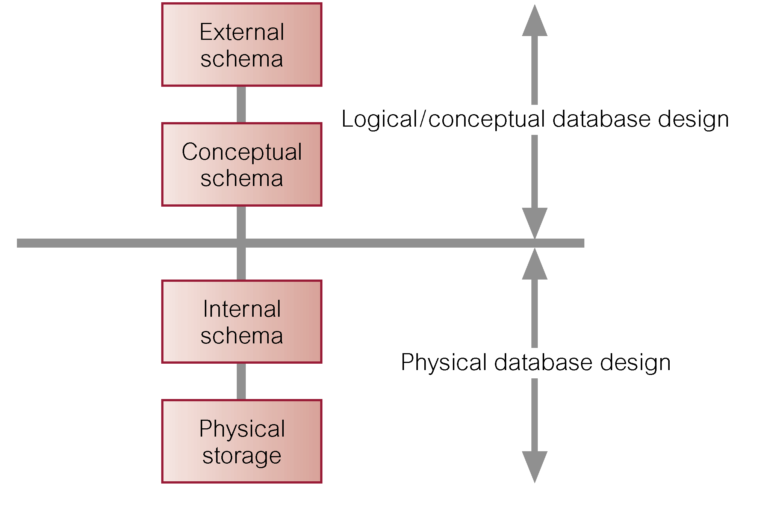
Three-Level ANSI-SPARC Architecture and Phases of Database Design

Slide 26
5. DBMS Selection
Selection of an appropriate DBMS to support the database system.
Undertaken at any time prior to logical design provided sufficient information is available regarding system requirements.
Main steps to selecting a DBMS:
define Terms of Reference of study;
shortlist two or three products;
evaluate products;
recommend selection and produce report.

Slide 27
6. Application Design
Design of user interface and application programs that use and process the database.
Database design and application design are parallel activities.
Includes two important activities:
transaction design;
user interface design.

Slide 28
7. Prototyping
Building working model of a database system.
Purpose
to identify features of a system that work well, or are inadequate;
to suggest improvements or even new features;
to clarify the users’ requirements;
to evaluate feasibility of a particular system design.

Slide 29
8. Implementation
Physical realization of the database and application designs.
Use DDL to create database schemas and empty database files.
Use DDL to create any specified user views.
Use 3GL or 4GL to create the application programs. This will include the database transactions implemented using the DML, possibly embedded in a host programming language.

Slide 30
9. Data Conversion and Loading
Transferring any existing data into new database and converting any existing applications to run on new database.
Only required when new database system is replacing an old system.
DBMS normally has utility that loads existing files into new database.
May be possible to convert and use application programs from old system for use by new system.

Slide 31
10. Testing
Process of running the database system with intent of finding errors.
Demonstrates that database and application programs appear to be working according to requirements.
Evaluation conducted against a usability specification. Examples of criteria include:
Learnability;
Performance;
Robustness;
Recoverability;
Adaptability.

Slide 32

11. Operational Maintenance
Process of monitoring and maintaining database system following installation.
Monitoring performance of system.
if performance falls, may require tuning or reorganization of the database.
Maintaining and upgrading database application (when required).
Incorporating new requirements into database application.
http://orbex.co.in

Slide 33
CASE Tools
Support provided by CASE tools include :
Data dictionary to store information about database system’s data
Design tools to support data analysis
Tools to permit development of corporate data model, and conceptual and logical data models
Tools to enable prototyping of applications.

Slide 34

CASE Tools
Provide following benefits:
Standards;
Integration;
Support for standard methods;
Consistency;
Automation .
edlivetoday.com

Slide 35
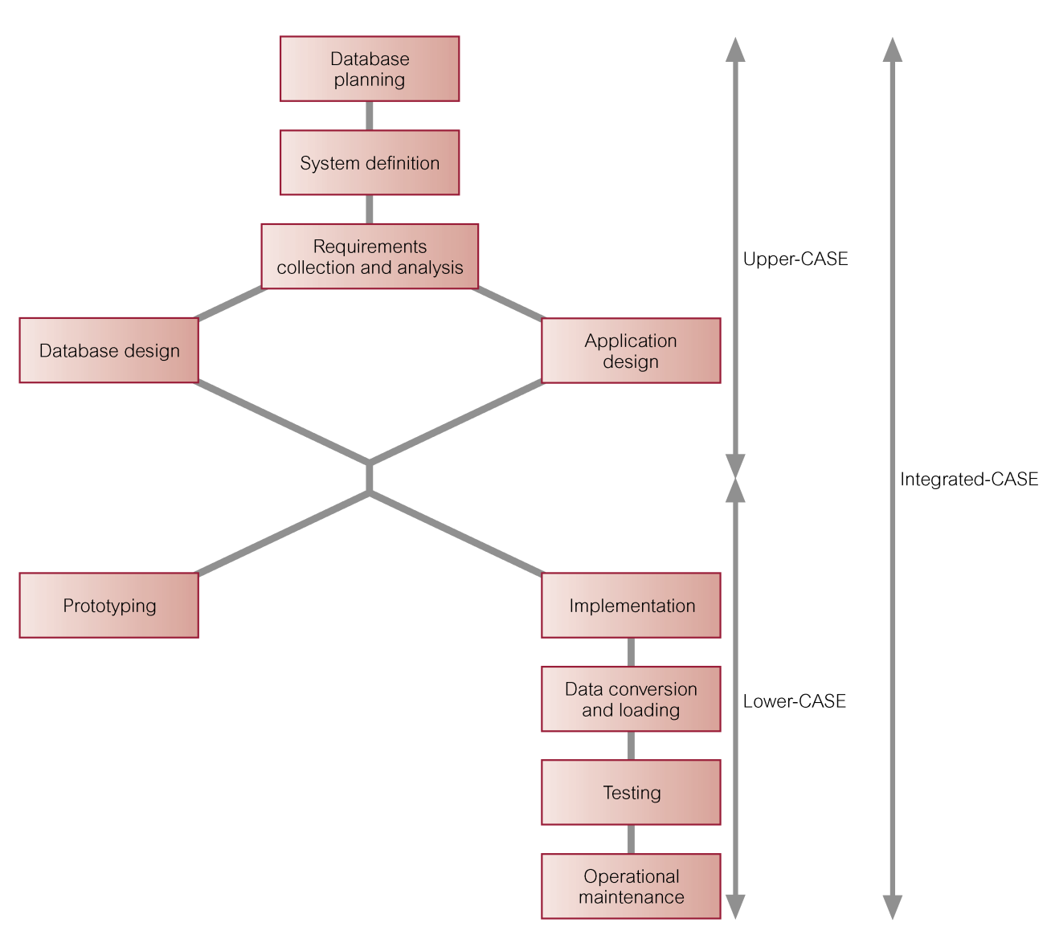
CASE Tools and Database System Development Lifecycle

Slide 36

www.healthytravelblog.com

